Slide 1

Financial
Reporting Controls
For VFW Home Associations
Presented by Robert J. Eyer, CPA

Slide 2

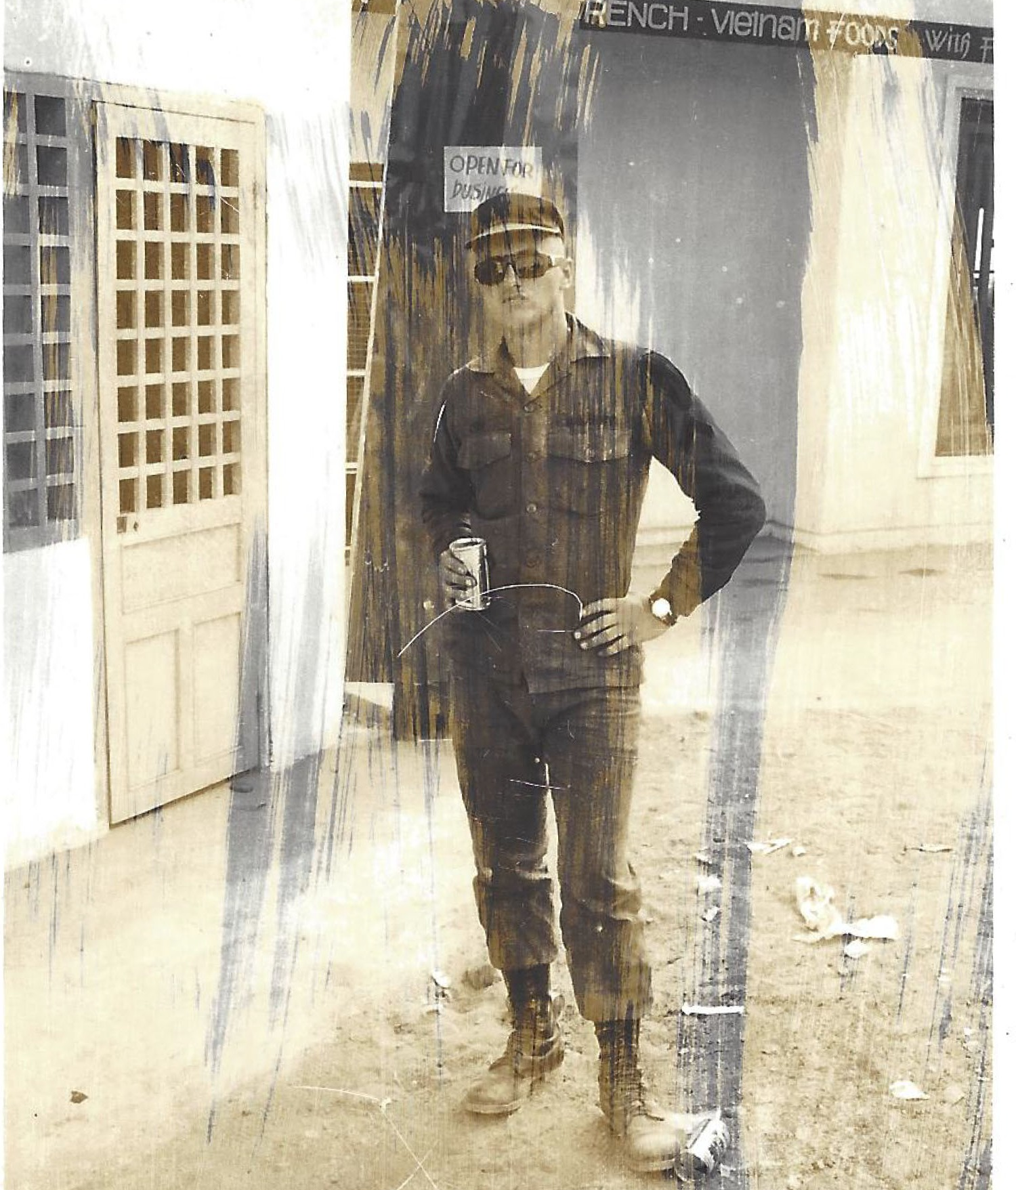
Robert Eyer, CPA, is a Shareholder Emeritus at Wessel & Company. Robert supports the firm through his work with strategic planning, succession planning, mergers and acquisitions and ESOP. He services manufacturing and government contracting industries. Currently, Bob works closely with the firm’s clients helping them meet their strategic objectives. He has considerable experience in large private entity audits and tax planning for closely held businesses.
Professional Background
Robert joined the firm after working in a national firm environment for many years. He uses his knowledge and experience from the “big eight background” to develop a niche driven firm. He credits not only his business experience for growing the firm to almost 50 people, but also his military background which taught him to meet objectives and get the job done.
Education and Associations
Mr. Eyer has an Accounting degree, and his associations include the American Institute of Certified Public Accountants (AICPA) and the Pennsylvania Institute of Certified Public Accountants (PICPA).
Personal Background
Bob serves on the boards of Concurrent Technologies Corporation, Johnstown Area Regional Industries, Community Foundation for the Alleghenies, Vision 2025, and Veterans Community Initiatives, Inc.

Slide 3

Must operate the bar as a "real business"
Must have financial controls
Must prepare monthly financial reports
Must use the financial reports to make business decisions - Timely
Overarching Principles

Slide 4
Required Experience/Knowledge
Normally need to hire a bookkeeper/accountant to prepare monthly financial statements
Financial statements and information must be used by quartermaster, commander, and bar manager to make business decisions on a timely basis

Slide 5

Develop procedures to reconcile cash in the checking accounts to the cash recorded in QuickBooks or other accounting software
Account for all cash on hand
Reconcile cash held or "unpulled" SGOC from POS software to actual cash
Have the provider of the skills games send weekly net by check or ACH transfer – No Cash Please!
Overall treat cash as RADIOACTIVE
Reconcile All Cash Daily & Monthly

Slide 6

Financial Statements
Use a customized chart of accounts – What does it look like?
Use account numbers and not a chart of accounts organized in alphabetical order
Balance Sheet – Reflect assets, liabilities and net worth
Income Statement – Reflect revenue, cost of sales, and major areas of operating expenses
Income Statement
Structure
Sales by major category
Cost of Sales by major category of revenue
Gross Profit – This is a key performance indicator (KPI) (See industry study)
Gross Profit is impacted by "free drinks" for post meetings and ceremonies
Possible solutions to maintain accountability and provide for a good financial reporting

Slide 7



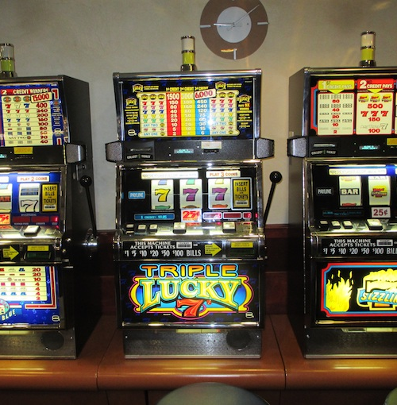
Gambling
Income
SGOC
Veterans
Tax/Regulations
Major source of income
Clubs could not survive without it
Must comply with rules for SGOC
Stress use of profits to primarily benefit veterans
Skills may now be taxes and regulated by state

Slide 8

Dashboard
The Ultimate "One Pager"
QuickBooks income statements can be confusing and overwhelming
Solution – Dashboard for all the information you ever needed
Provides all the KPI's to manage the bar operations

Slide 9


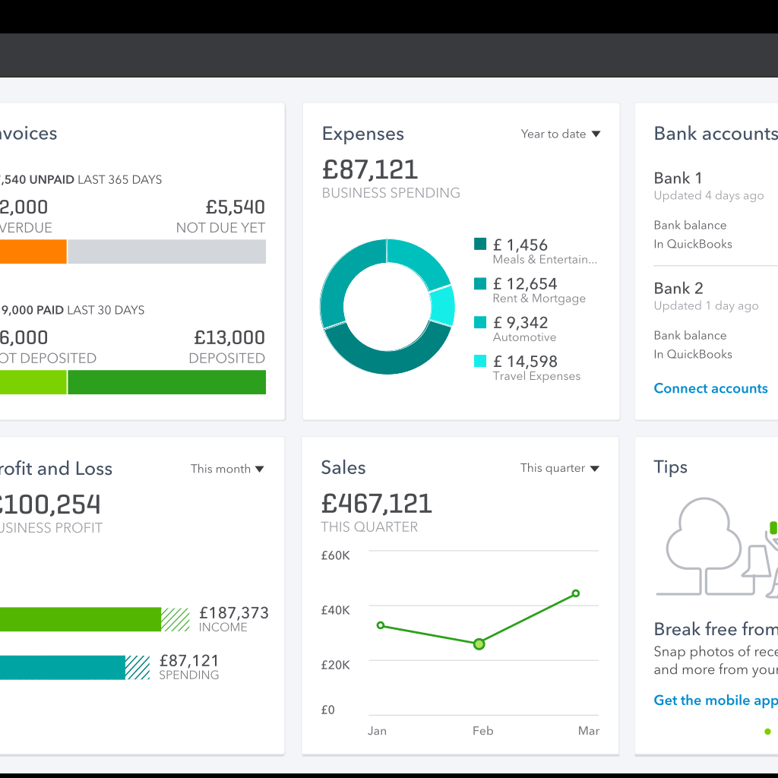
Accounting Software
Most Used Option QuickBooks
Desktop Option
Process disbursements as checks written/recorded
Desktop Option
Download from bank – Two Options
Direct Connect (like QB Online)
Manual Connect – Download a transaction file from the bank website and then open it in QB desktop and it will populate the bank feeds screen
Depending on the bank manual connect may be the only option
Quickbooks Online
How to set up your company
How to connect to the bank

Slide 10


Cash Reconciliations
to Bar Revenues
Reconcile monthly deposits to the Z report from your point-of-sale software
Reconciliations issues
Deposits not made daily
Cash on hand from SGOC for games not pulled
Beginning cash for bar tender
Emergency cash
Skills games weekly share – Have skills operator write a check or do an ACH transfer to your bank account
Treat cash as RADIOACTIVE
Quarterly – Quarter Master, Commander set up a procedure to reconcile and count ALL the cash

Slide 11

Best Practices
Organize filing system of all post documents, invoices, bank statements, contracts, employee records and use State VFW recommendations for document retention guidelines.
Quartermaster or Commander approve all invoices and contracts for payment.
Two signatures on checks and if a signature stamp is used never let it out of the user’s possession (just like your P – 38).
Ensure Form 990 is properly prepared, approved by officers, and timely filed.
Provide monthly financial statements or the dashboard to Home Association members for their review and approval.
Consider having annual financial statements compiled, reviewed or audited by an independence CPA firm.

